Slide 1
Mr. KNN:
Soft Relevance
for Multi-label Classification
(CIKM’10)
Date: 2011/1/11
Advisor: Dr. Koh. Jia-Ling
Speaker: Lin, Yi-Jhen

Slide 2
Preview
Introduction
Related Work
Problem Transformation Methods
Algorithm Adaptation Methods
The ML-KNN (Multi-Label K Nearest Neighbor) Method
Mr. KNN: Method Description
Experimental Results
Conclusion
Notes:
三種方法的障礙

Slide 3
Introduction
Multi-label learning refers to learning tasks where each instance is assigned to one or more classes(labels).
Multi-label classification is drawing increasing interest and emerging as a fast-growing research field.

Slide 4
Preview
Introduction
Related Work
Problem Transformation Methods
Algorithm Adaptation Methods
The ML-KNN (Multi-Label K Nearest Neighbor) Method
Mr. KNN: Method Description
Experimental Results
Conclusion
Notes:
簡述三種方法

Slide 5
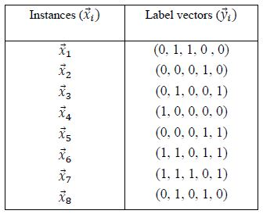
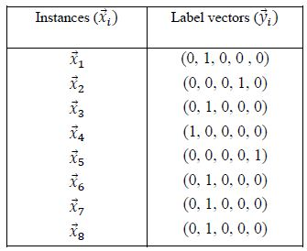
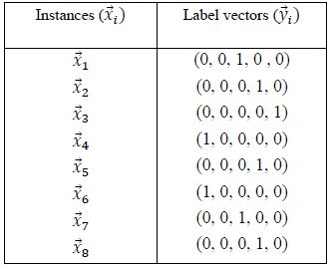
Related Work – Problem Transformation Methods
${\left\{\left(\overset{⃑}{x_{i}}, \overset{⃑}{y_{i}}\right)\right\}}_{i=1}^{n}$ : a training set of n multi-label examples
$\overset{⃑}{x_{i}}$: input vectors
$\overset{⃑}{y_{i}}$ : class label vectors (elements: 0 or 1)
For each multi-label instance, problem transformation methods convert it into a single label.
Select-max
Select-min
Freq.=(3, 5, 2, 4, 4)

Slide 6
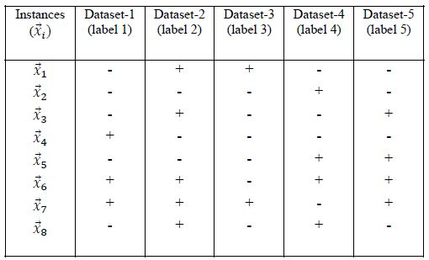
Related Work – Problem Transformation Methods
Another popular strategy is so-called binary relevance, which converts the problem into multiple single-label binary classification problems.
Multi-label instances are forced into one single category without considering distribution.

Slide 7
Related Work – Algorithm Adaptation Methods
Algorithm adaption methods modify standard single-label learning algorithm for multi-label classification.
single-label learning | multi-label learning | Algorithm Adaptation
Decision trees | adapted C4.5 | Allowing leaves of a tree to represent a set of labels
AdaBoost | AdaBoost .MH | Maintain a set of weights as a distribution over both training examples and associated labels
SVM | SVM-like optimization strategy | Be treated as a ranking problem and a linear model that minimizes a ranking loss and maximizes a margin is developed

Slide 8
Related Work – The ML-KNN Method
N$\left(\overset{⃑}{x_{i}}\right)$ : the k nearest neighbors of $\overset{⃑}{x_{i}}$
$c_{\overset{⃑}{x_{i}}}\left(j\right)$ : number of neighbors in $\overset{⃑}{x_{i}}$belonging to the j-th class
ML-KNN assigns the j-th label to an instance using the binary relevance strategy

Slide 9
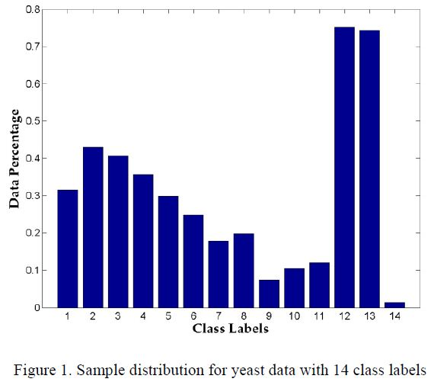
Related Work – The ML-KNN Method
$R_{j}$= $\frac{\# of positive examples}{\# of negitive examples}$
Data distributions for some labels are imbalanced
With the binary relevance strategy, the ratio estimation may not be accurate

Slide 10
Mr. KNN: Method Description
Mr.KNN consists of two components
Soft Relevance
A modified fuzzy c-means (FCM)-based approach to produce soft relevance
Mr.KNN: Volting-Margin Ratio Method
A modified kNN for multi-label classification
Fuzzy c-means algorithm (similar with k-means algorithm)
In fuzzy clustering, each point has a degree of belonging to clusters, as in fuzzy logic, rather than belonging completely to just one cluster.
We adapt the FCM algorithm to yield a soft relevance value for each instance with respect to each label

Slide 11
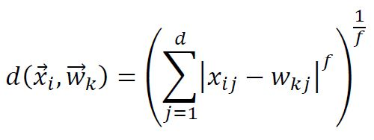
Soft Relevance
Treat each class as a cluster
$u_{ik}$ : the membership (relevance) value of an instance $\overset{⃑}{x_{i}}$ in class k
$\overset{⃑}{w_{k}}$ : the class center
To find an optimal fuzzy c-partition by minimizing:
m : a weighting exponent and set to 2
$d\left(\overset{⃑}{x_{i}}, \overset{⃑}{w_{k}}\right)$ : Minkowski distance measure

Slide 12
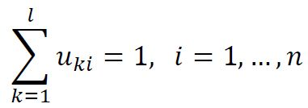
Soft Relevance
Constrains in FCM
Each membership $u_{ik}$ is between zero and one and satisfies :
Furthermore, the class labels for each training data are known, which can be formulated as follows:
For 5-class multi-label classification c1~c5
If an instance xi belongs to class c1, c2, c4
Then u3i = u5i = 0
And u1i + u2i + u4i = 1

Slide 13
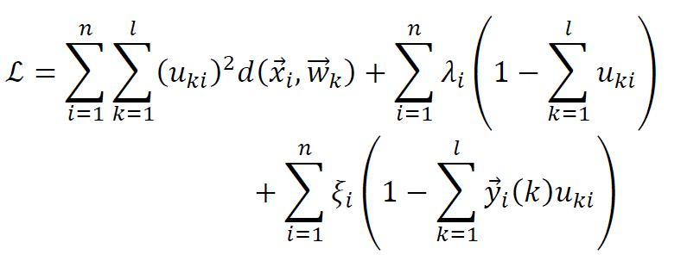
Soft Relevance
To find the membership values, we minimize the cost function Jm with the constrains in previous slide, this leads to the following Lagrangian function:
Update the new $u_{ik}$
Take the gradient with respect to $\overset{⃑}{w_{k}}$
Update the new$\overset{⃑}{{ w}_{k}}$
Can be solved by the Gauss-Newton method

Slide 14
Mr.KNN: Voting-Margin Ratio Method
In general, the voting function relates an instance $\overset{⃑}{x_{i}}$ and the j-th class is defined as:
Two issues
The imbalanced data distribution
Doesn’t take into account the distance between a test instance and its k nearest neighbors
We incorporate a distance weighting method and the soft relevance $u_{jb}$ derived from previous slide, the new voting function:
$$e^{−∞}$$ | $$e^{0}$$ | $$e^{∞}$$
$$0$$ | 1 | $$∞$$

Slide 15
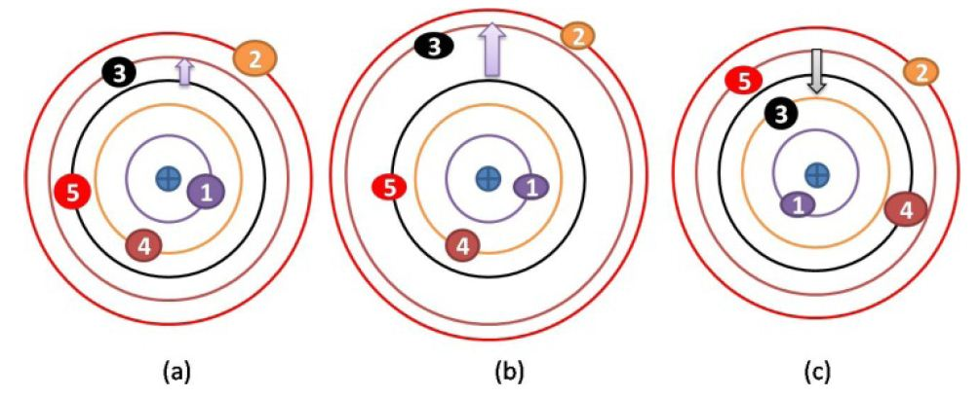
Mr.KNN: Voting-Margin Ratio Method
To determine the optimal values of f in Minkowski distance and K in kNN, we introduce a new evaluation function, which is motivated by the margin concept (voting margin)
Consider a 5-class learning problem with an instance belonging to two class labels: labels 2 and 3
The instance: the plus inside a circle
A circle represents a voting value for the label marked by the number inside a circle
Correct voting
Smaller margin
Correct voting
larger margin
True label 3 is lower than
false labels 4 & 5

Slide 16
Mr.KNN: Voting-Margin Ratio Method
voting margin
Ti : true label set
Fi : false label set
Our goal is to seek the combination of f and k that maximizes the average voting margin ratio
The overall learning method for multi-label learning is called voting Margin Ration kNN, or Mr.KNN

Slide 17
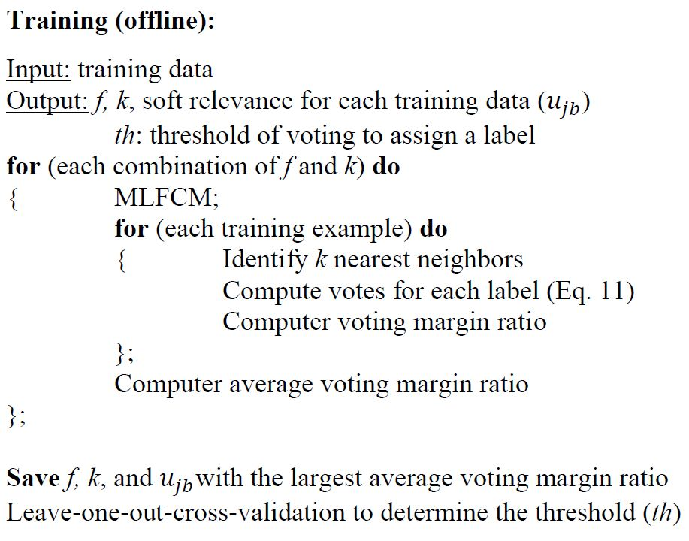
Mr.KNN: Voting-Margin Ratio Method
Mr.KNN consists of two steps: training and test. The procedures are as follow

Slide 18
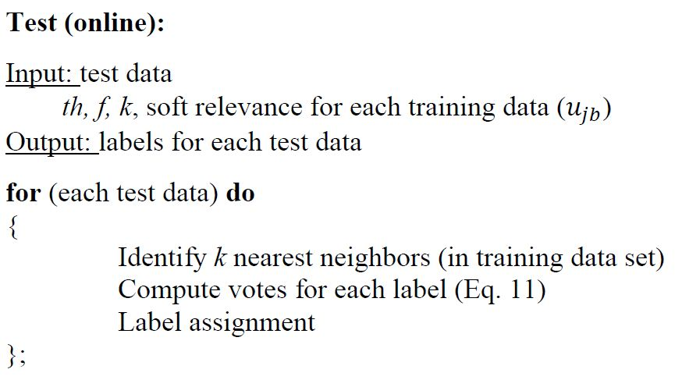
Mr.KNN: Voting-Margin Ratio Method
Mr.KNN consists of two steps: training and test. The procedures are as follow

Slide 19
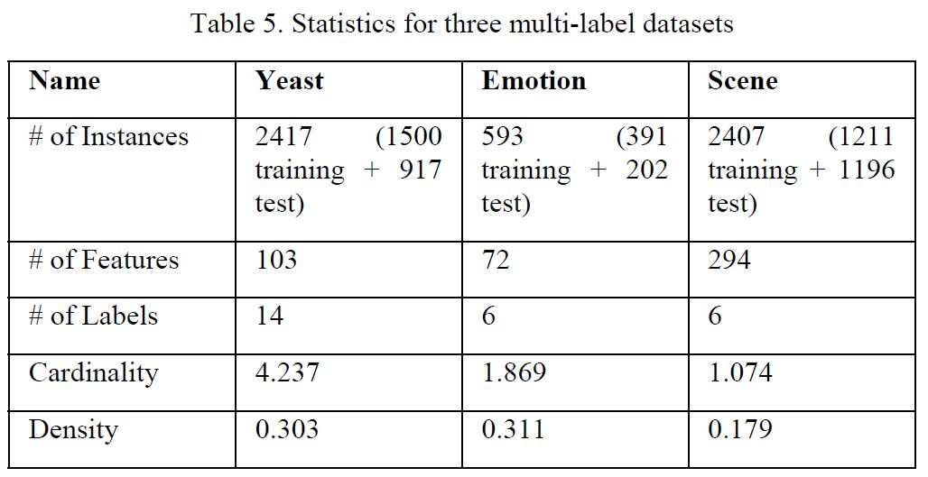
Experimental Results – Data Description
Three multi-label datasets are tested in this study
Predict gene functions of yeast
Detection of emotions in music
Semantic scene classification

Slide 20
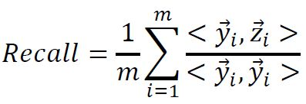
Experimental Results – Evaluation Criteria
Four criteria to evaluate performance of learning methods
Hamming Loss
Accuracy
Precision
Recall
${\left\{\left(\overset{⃑}{x_{i}}, \overset{⃑}{y_{i}},\overset{⃑}{z_{i}}\right)\right\}}_{i=1}^{m}$ : a test data
$\overset{⃑}{x_{i}}$ :a test instance
$\overset{⃑}{y_{i}}$ : class label vector (0/1)
$\overset{⃑}{z_{i}}$ : predict label vector (0/1)

Slide 21
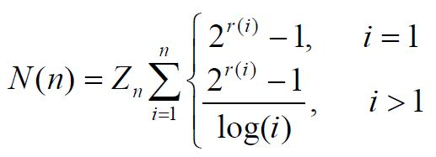
Experimental Results – Evaluation Criteria
Also use NDCG (normalized discounted cumulative gain) to evaluate the final ranking of labels for each instance
For each instance, a label will receive a voting score
Ideally, these true labels will rank higher than false labels
The NDCG of a ranking list of labels at position n is

Slide 22
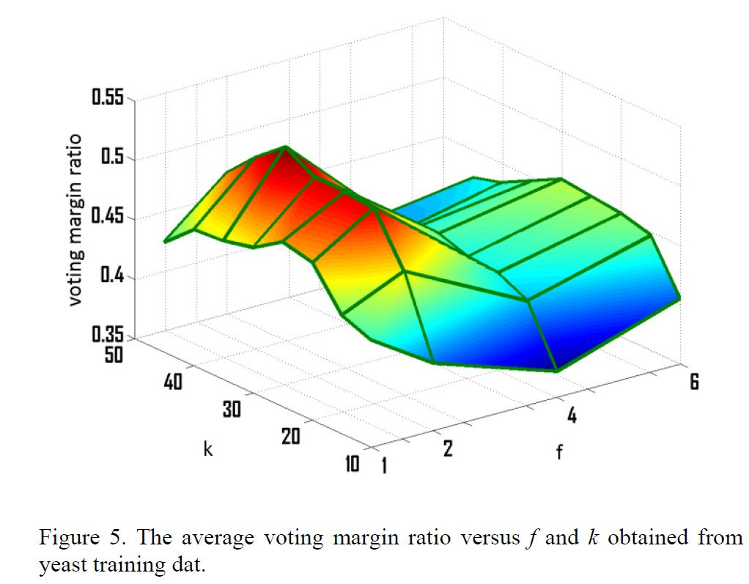
Experimental Results
For each dataset
select the f in Minkowski distance form 1, 2, 4, 6
K in kNN from 10, 15, 20, 25, 30, 35, 40, 45
Total 32 combinations of (f, k)

Slide 23
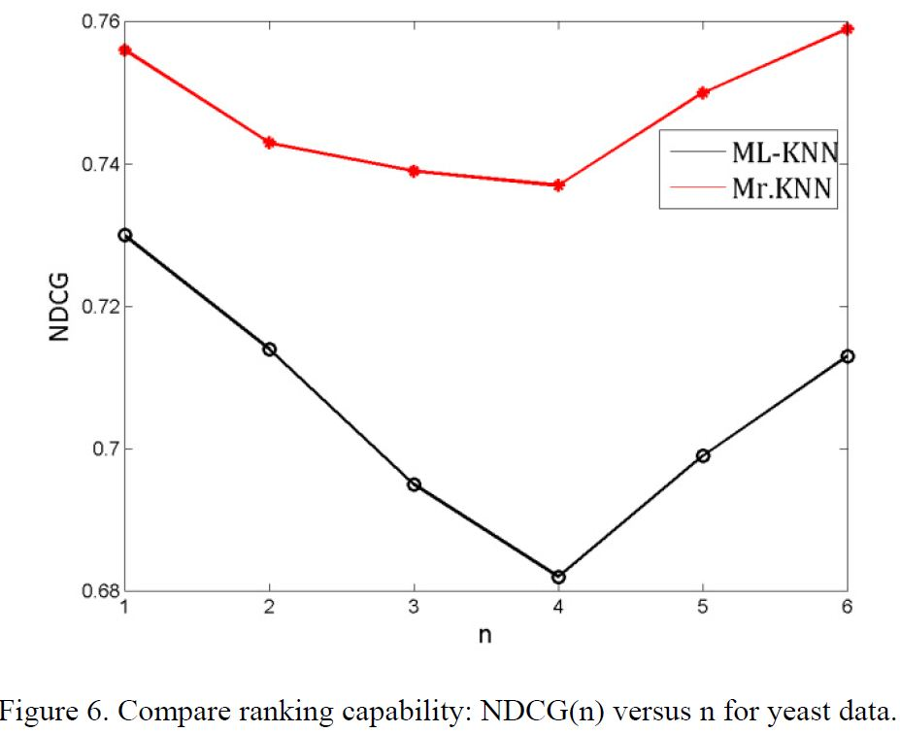

Slide 24
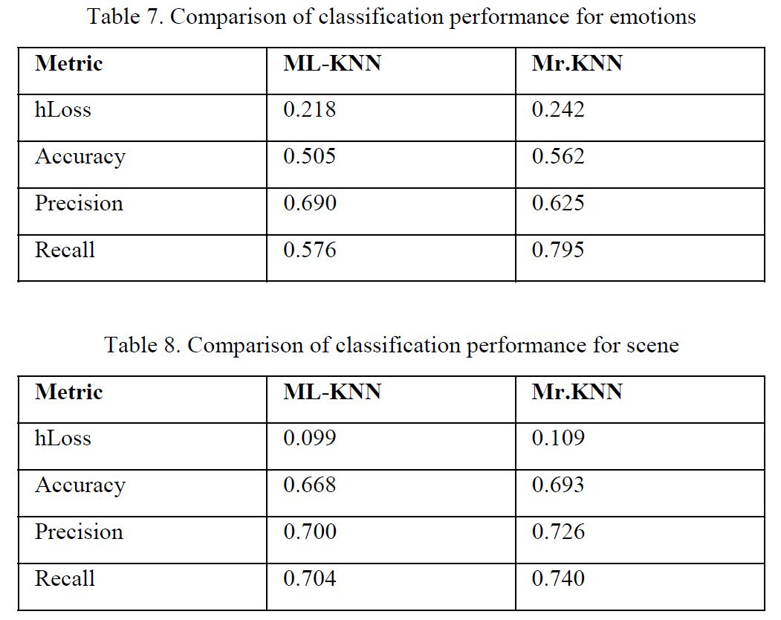

Slide 25
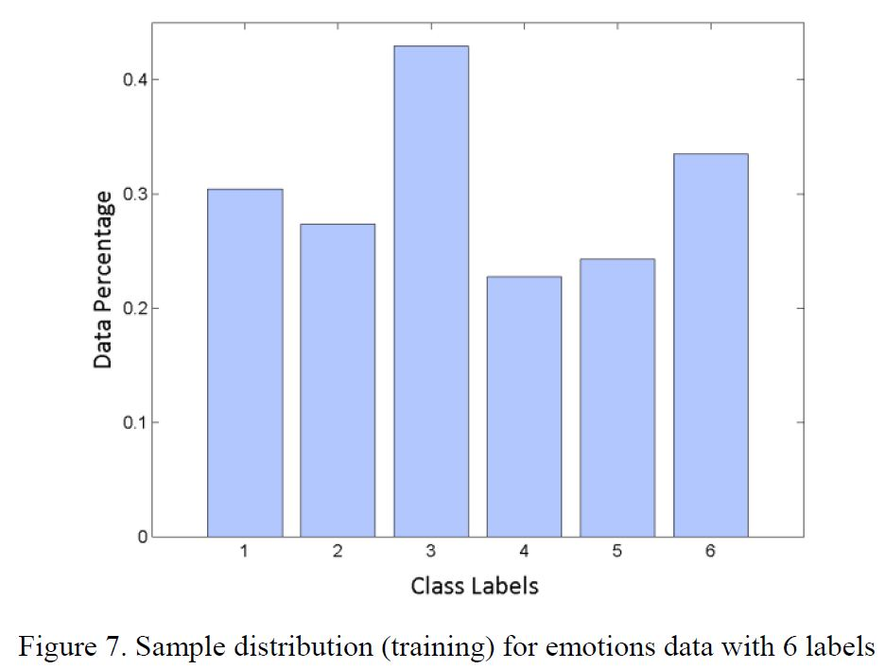
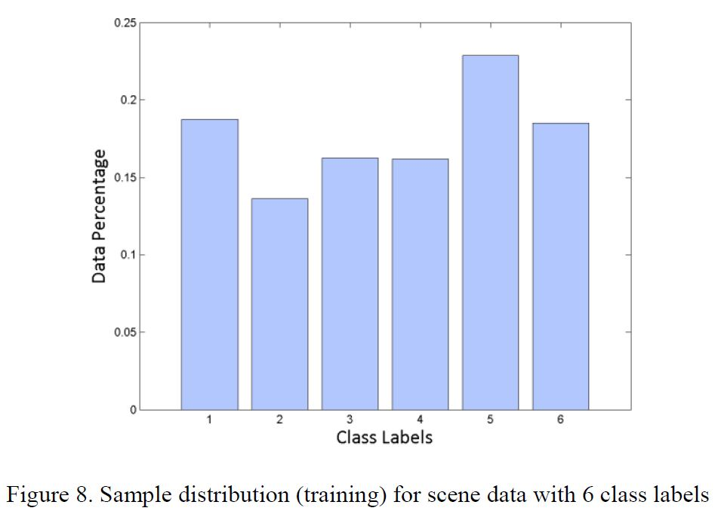

Slide 26
Conclusion
We introduce the soft relevance strategy, in which each instance is assigned a relevance score with respect to a label
Furthermore, it is used as a voting factor in a modified kNN algorithm
Evaluated over three multi-label datasets, the proposed method outperforms ML-KNN

